Slide 1
Dataset overview
7,043
26.5%
9 → 12
80 / 20
customers in the dataset
churned (about 1 in 4)
attributes become model inputs
train / test split (5,634 / 1,409)
Data preparation (data_preprocessing.py)
Categories encoded as 0/1 or one-hot columns
80/20 split, stratified on churn, so both parts keep 26.5% churn
Scaler fitted on training data only; no missing values
Notes:
Hello. This video presents the predictive modelling part of my project: a neural network that predicts which telecommunications customers will leave, which we call churn. Let me start with the dataset. It contains 7,043 customers, and 26.5 percent of them churned, so roughly one in four. Each customer has nine attributes: gender, senior citizen status, dependents, tenure in months, phone and internet service, contract, and monthly charges. Once the categories are encoded, these nine attributes become twelve model inputs. The data was prepared in the script data_preprocessing.py. Categories were encoded as zeros and ones, and the data was split eighty-twenty, stratified on churn, so both parts keep the same churn rate. That gives 5,634 customers for training and 1,409 customers for testing that the model never sees while it learns. The two numeric fields were standardised using the training data only, so nothing from the test set leaks into training. The raw data has no missing values. All of this, with the code and results, is in the Predictive Modeling folder of my repository.

Slide 2
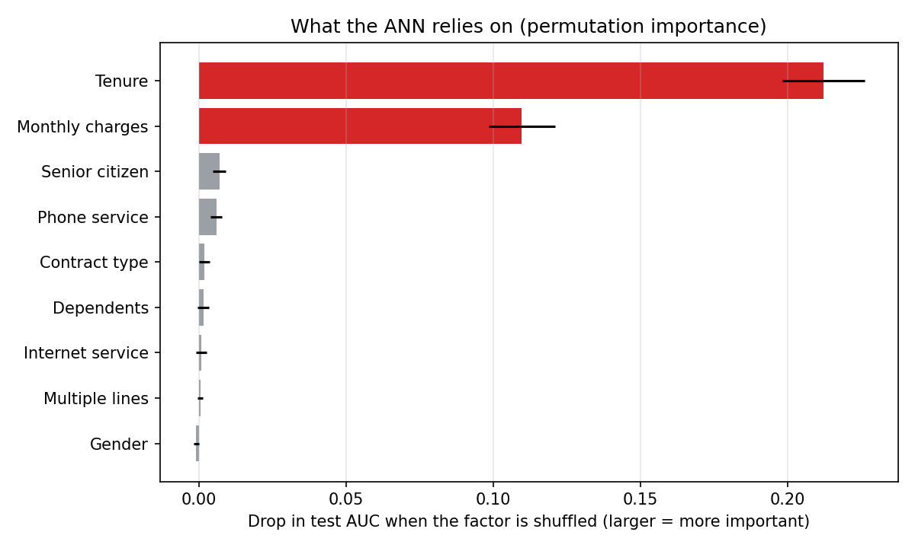
Feature selection
All 9 attributes used
Shuffling one factor at a time shows how much the model relies on it
Tenure and monthly charges dominate
Contract type, internet service and gender add almost nothing
Drop in test AUC when each factor is shuffled
Notes:
Next, feature selection. I kept all nine attributes, but I wanted to know which of them the model really relies on. To measure this I used permutation importance: I shuffle one factor at a time in the test data and see how much the model's AUC drops. A big drop means the model depends on that factor. This chart shows the result. Tenure is by far the most important, with a drop of 0.21, followed by monthly charges at 0.11. Every other factor is close to zero, including contract type, internet service and gender. In fact, a simple logistic regression using only four inputs, tenure, monthly charges, senior citizen and dependents, reaches an AUC of 0.80, almost the same as using all twelve. So the model is driven mainly by how long customers have stayed and how much they pay. Contract type having no effect is unusual for telecommunications data, and I will come back to it in the limitations.

Slide 3
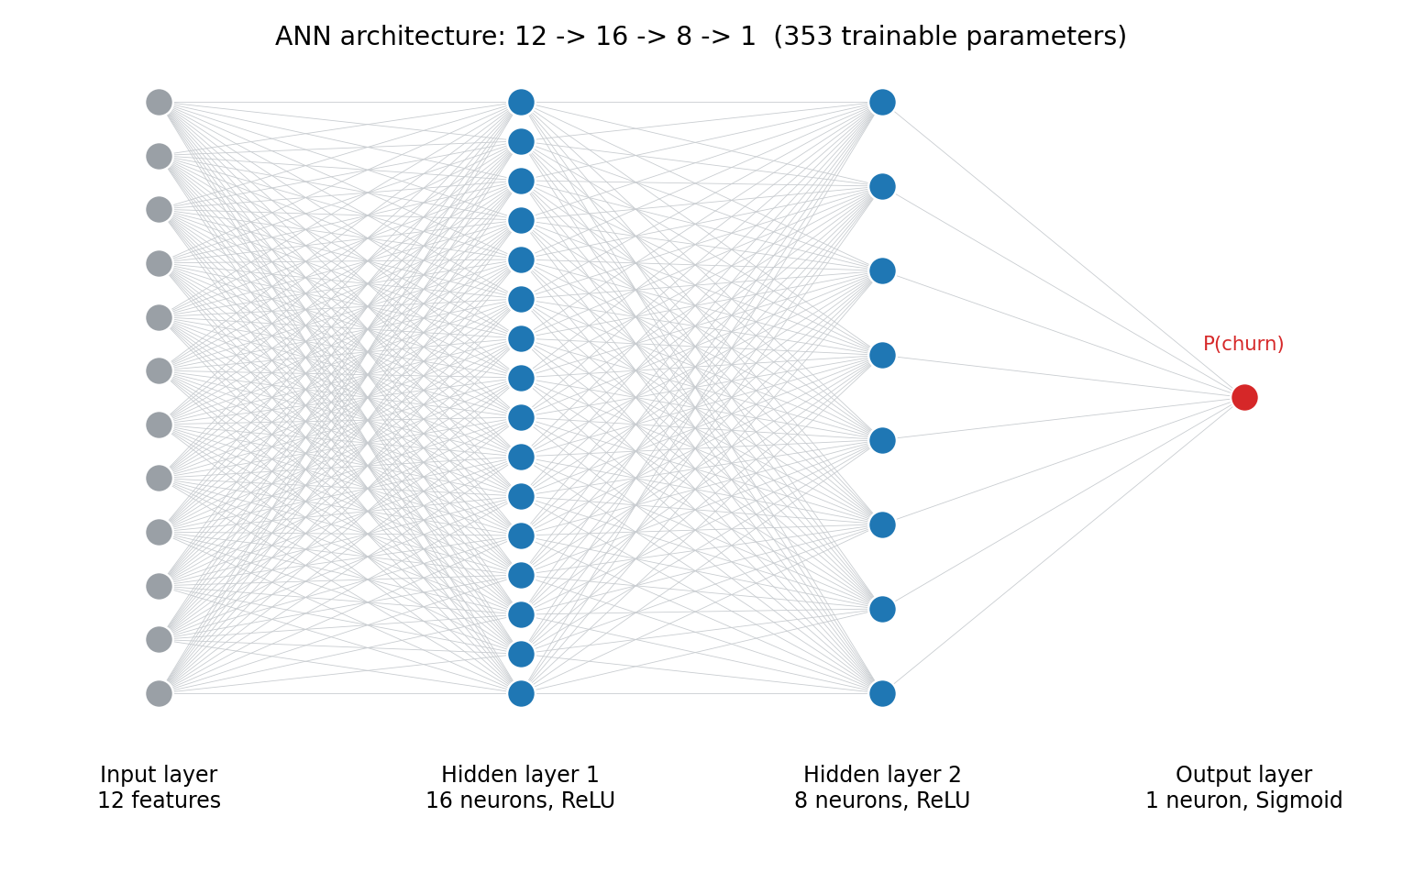
ANN architecture
12 → 16 → 8 → 1
ReLU hidden, sigmoid output
353
trainable parameters
Adam · BCE · 32
optimiser · loss · batch size
Notes:
Now the architecture of the neural network. It has an input layer with twelve neurons, one for each input. The first hidden layer has sixteen neurons and the second has eight, and both use the ReLU activation, which trains quickly. The output layer has one neuron with a sigmoid activation, which produces a probability between zero and one: the chance that this customer will churn. Altogether the network has 353 trainable parameters. I kept it small on purpose. With about fifty-six hundred training customers, a large network could simply memorise the data. I also tested a bigger network with sixty-four and thirty-two neurons plus dropout, and it performed no better, so the smaller design was kept. For training I used the Adam optimiser, which adapts the learning speed automatically, binary cross-entropy as the loss function, which suits a yes or no prediction, and a batch size of 32. The full description, with the reasons for each choice, is in the document ANN_Architecture.docx.

Slide 4
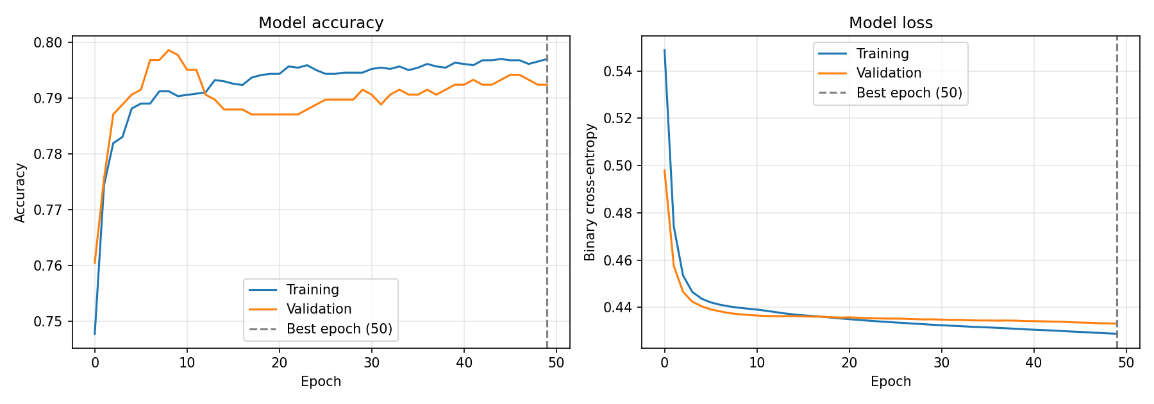
Training process
Loss 0.55 → 0.43 · training and validation lines stay together: no overfitting
Final results: training 79.7% · validation 79.2% · test 78.2% accuracy
Notes:
Here is the training process. The model trained for up to fifty epochs, with twenty percent of the training data held out for validation, and early stopping that would keep the best version if the validation loss stopped improving. On the right is the loss, the model's error. It starts at about 0.55, falls quickly in the first five epochs, and settles at about 0.43 by epoch fifteen. On the left is accuracy, which rises and levels off at about 79 percent. The most important thing in this chart is that the training and validation lines stay almost on top of each other. That means the model is learning real patterns, and is not just memorising the training data, which would show up as the validation line getting worse. The final results at epoch fifty are a training loss of 0.4289 with accuracy of 79.7 percent, a validation loss of 0.4331 with accuracy of 79.2 percent, and on the test set an accuracy of 78.2 percent. I also retrained with five different random seeds, and the AUC stayed at 80.6 percent, within 0.1 of a point, so the result is stable.

Slide 5
Model evaluation
Model | Accuracy | Precision | Recall | F1 | AUC
Neural network, threshold 0.50 | 78.2% | 60.7% | 50.8% | 55.3% | 80.5%
Neural network, tuned threshold 0.39 | 76.7% | 55.2% | 63.9% | 59.2% | 80.5%
Logistic regression (baseline) | 79.4% | 65.4% | 47.6% | 55.1% | 80.7%
50.8% → 63.9%
Same AUC
recall (leavers caught) after tuning the threshold on validation data
as a simple logistic regression: the limit is the data, not the network
Notes:
Now the evaluation, on the 1,409 test customers. This table compares three setups. First, the neural network at the default threshold of 0.50: accuracy 78.2 percent, precision 60.7, recall 50.8, F1 55.3 and AUC 80.5. Recall is the share of real leavers we catch, and at the default threshold it is only about half. So I tuned the threshold on validation data, not on the test set, and chose 0.39. In the second row, recall rises to 63.9 percent, with precision of 55.2 and F1 of 59.2. We contact more customers who would have stayed, but we catch many more of those who leave. Because losing a customer usually costs more than a retention offer, this is the setting I recommend. The third row is a simple logistic regression. It reaches almost the same AUC, 80.7 percent. This tells us the limit comes from the information in the data, not from the design of the network.

Slide 6
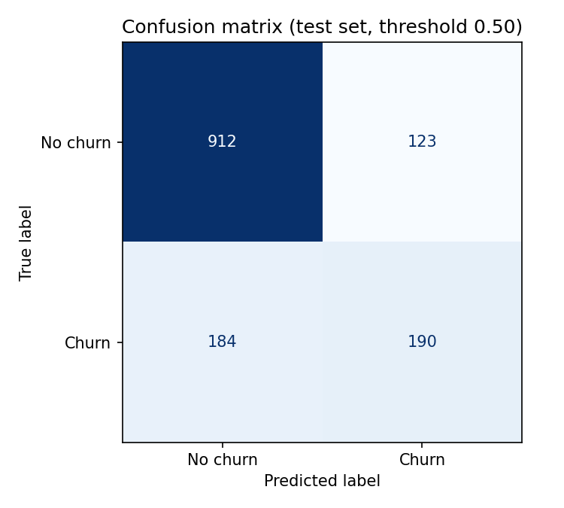
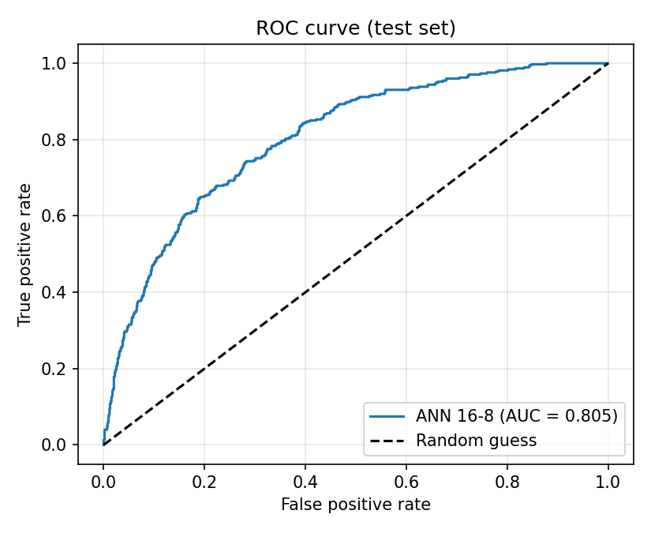
Accuracy and confusion matrix
78.2%
test accuracy
190 / 374
leavers caught
AUC 0.805
ranking quality
At threshold 0.50: 912 stayers correct, 123 false alarms, 184 leavers missed, 190 leavers caught.
Notes:
Let me look at accuracy in more detail. The confusion matrix on the left, at threshold 0.50, shows what the model got right and wrong. In the top row, 912 customers who stayed were correctly identified, and 123 were wrongly flagged as leavers. In the bottom row, 184 leavers were missed, and 190 were caught. So of the 374 customers who really churned, the model caught 190. Overall accuracy is 78.2 percent. The ROC curve in the middle plots the catch rate against the false alarm rate as the threshold changes. The curve bends well above the dashed line, which is random guessing, and the area under it, the AUC, is 0.805. Put simply, if I pick one customer who left and one who stayed, the model gives the leaver the higher risk score about eighty percent of the time.

Slide 7
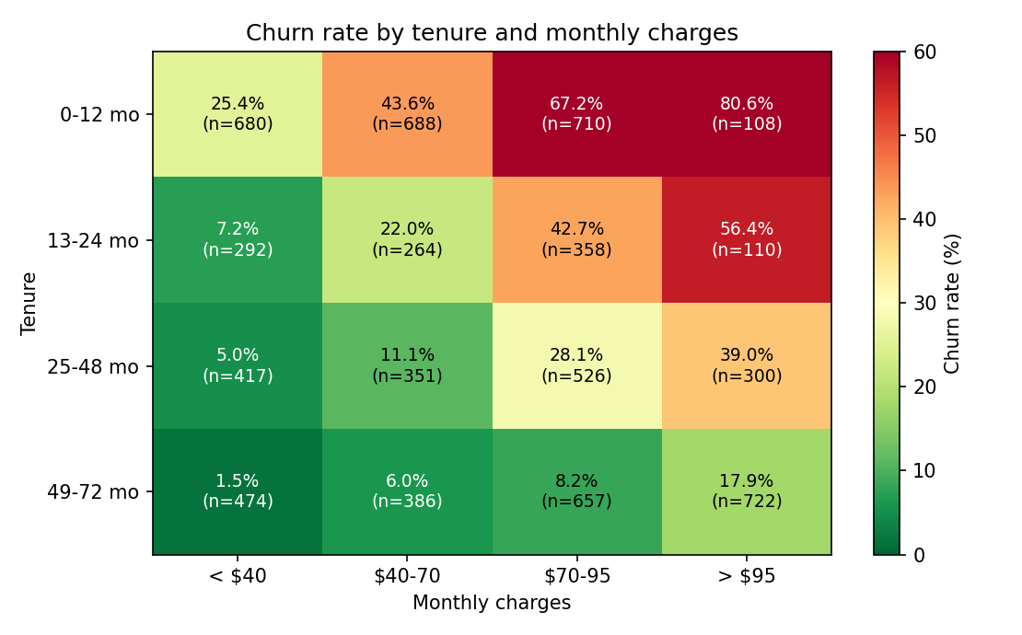
Churn prediction results
Customer | Tenure | Charges | Risk | Outcome
Highest risk | 1 mo | $79 | 86.1% | Left
Near threshold | 35 mo | $101 | 39.1% | Left
Lowest risk | 72 mo | $20 | 0.4% | Stayed
315
first-year customers flagged in the test set: a list to refresh every month
New and paying over $95: 80.6% churn. Over 4 years and under $40: 1.5%.
Notes:
Now the churn predictions themselves. For every test customer the model gives a churn probability, and above the threshold we flag the customer for action. This table shows three examples. The first is a senior customer with one month of tenure paying 79 dollars a month: the model gives an 86.1 percent chance of churn, and the customer did leave. The second, with 35 months and 101 dollars, is right at the threshold with 39.1 percent, and also left. The third, with 72 months paying only 20 dollars, has a probability of 0.4 percent, and stayed. The heatmap shows the pattern the model has learned: churn by tenure and monthly charges. New customers in their first year paying over 95 dollars churn at 80.6 percent, while customers with more than four years paying under 40 dollars churn at only 1.5 percent. Using the tuned threshold, 315 first-year customers in the test set are flagged, and the business could refresh this list every month.

Slide 8
Limitations and next steps
Few attributes
Only 4 of 9 relate to churn.
Fix: add usage, billing and support data.
Unreliable fields
Contract and internet show no link to churn.
Fix: verify with the data provider.
Duplicate records
302 duplicates; clean-test AUC 0.791 vs 0.805.
Fix: add a customer ID.
Loyal churners missed
Only about 12% of long-standing leavers caught.
Fix: add behavioural data.
Notes:
Finally, the limitations. First, the data has only nine attributes, and only four of them relate to churn, so the model has limited information. Second, contract type and internet service show no relationship with churn, which is unusual, so I recommend checking those fields with the data provider. Third, there are duplicate records: 302 in the raw data, and 93 of the test customers are identical to a training customer. When I remove them, the AUC falls from 0.805 to 0.791, so my headline figure is slightly optimistic. A customer ID would let us remove duplicates properly. Fourth, the model rarely detects long-standing customers who leave; it catches only about twelve percent of them, because tenure and charges say little about why a loyal customer would go. Behavioural data, such as usage and support contacts, would help. To summarise, the neural network predicts churn with an AUC of about 80 percent and catches nearly two thirds of leavers at the tuned threshold. The next step is better data. Thank you for watching.

